Slide 1
UNIT B:
Reproduction & Development
BIOLOGY 30

Slide 2
Chapter 14
The Reproductive System

Slide 3
Chapter 14 The Reproductive System
The male reproductive system (​key structures, spermatogenesis, secondary sex characteristics)
Male sex hormones (roles of testosterone, LH & FSH)
The female reproductive system (key structures, oogenesis, secondary sex characteristics)
Sexually transmitted infections
Hormonal regulation of gametogenesis
Textbook pages 476-505

Slide 4
Male and female reproductive systems are characterized by distinct…
Gonads (gamete-producing organs → testes vs. ovaries)
Sex hormones (testosterone vs. estrogen)
Gametes (sex cells → sperm vs. eggs)
Primary sex characteristics
  These are the reproductive organs/structures
  Typically present at birth but further develop during puberty
Secondary sex characteristics
  features not directly related to reproduction
  Develop over time, especially after puberty, in response to increased sex-hormone levels
  e.g. facial hair, voice changes, breast development, etc.

Slide 5
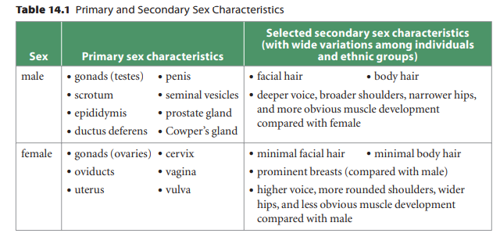
Primary vs. Secondary Sex Characteristics

Slide 6
Control of Reproductive System
Sex Determination
  How do embryos develop into male or female?
  There are 23 pairs of chromosomes in humans (46 total)
  The 23rd pair is the sex chromosome pair, and are different between male/female
    Females have two ‘X’ chromosomes (XX)
    Males have an X and a Y chromosome (XY)
  The presence of a Y chromosome stimulates the production of testes
    Testes in turn secrete testosterone which leads to the development of male sex characteristics 6-7 weeks after fertilization

Slide 7
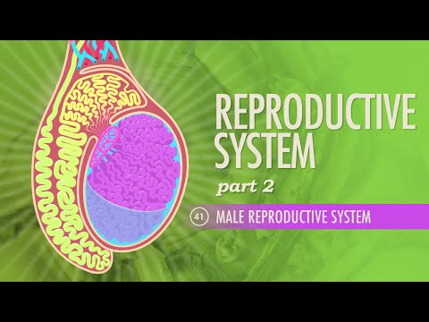
The Male Reproductive System

Slide 8
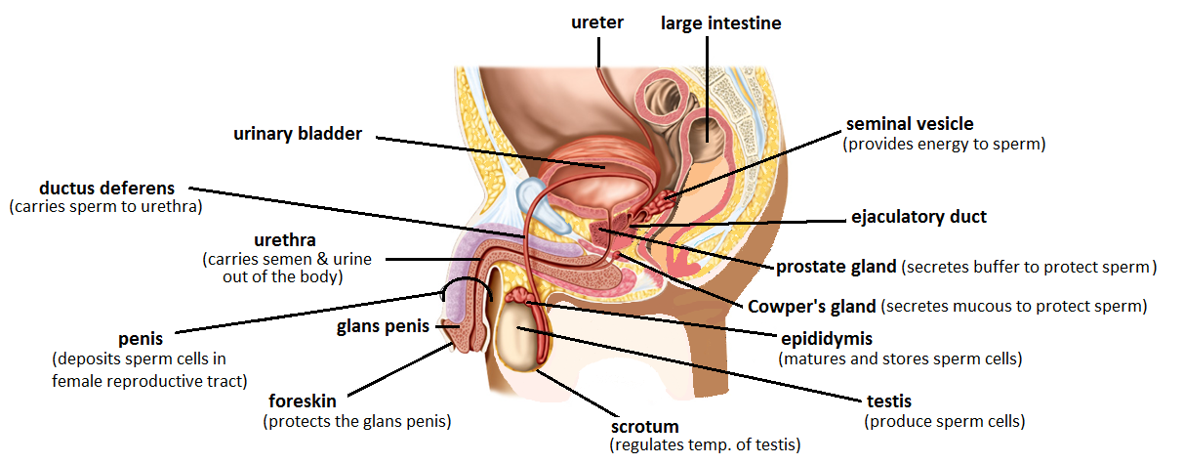
The Male Reproductive System
*you need to know all these structures and functions. A more comprehensive table with functions is on a later slide.
*
(secretes fructose into semen to provide energy)
*
*
*
*
(secretes alkaline mucus to protect sperm)
*
(secretes alkaline mucus to protect sperm)
*
*
*
*
(produces sperm in seminiferous tubules)

Slide 9
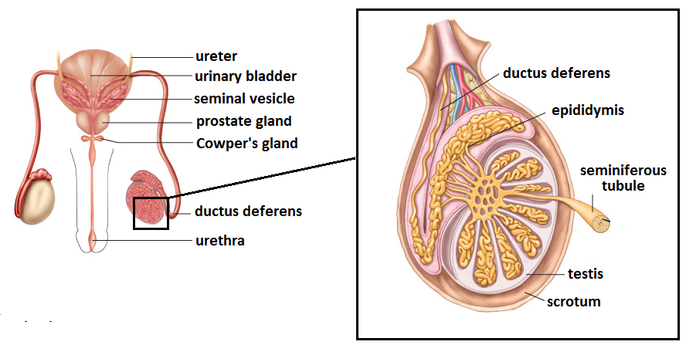
Can you match the structures on the previous page to a front view diagram?
(Answers on the next slide)

Slide 10
Male Reproductive Structures
(Front View)

Slide 11
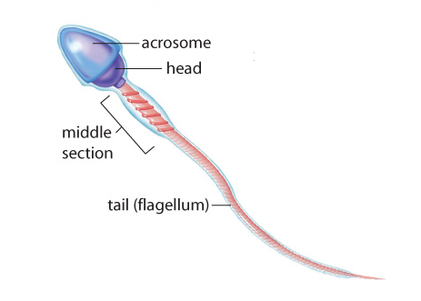
Sperm: The Male Gamete
(sex cells)
Produced in large amounts throughout a male’s lifespan starting at puberty
Flagellum allows sperm to propel themselves through the female reproductive system
Acrosome cap releases enzymes which enable sperm to penetrate the outer layers of the female egg

Slide 12
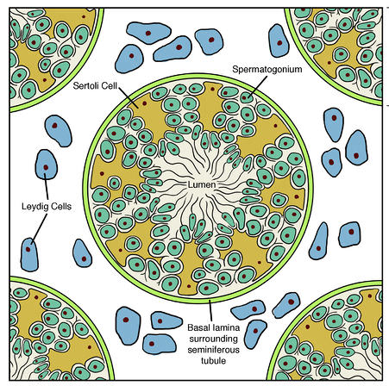
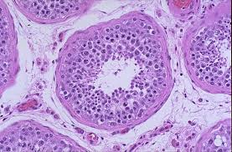
SPERMATOGENESIS (Sperm production)
The testes are composed of long, coiled tubes called seminiferous tubules; this is where sperm are produced during spermatogenesis
Testes also contain testosterone-secreting cells called interstitial cells (also known as Leydig cells), that surround the seminiferous tubules. The testosterone released by the interstitial cells is also indirectly involved in spermatogenesis by stimulating various functions of Sertoli cells.
Seminiferous tubule (cross section)
Interstitial cells
Interstitial cells
Interstitial
cell

Slide 13
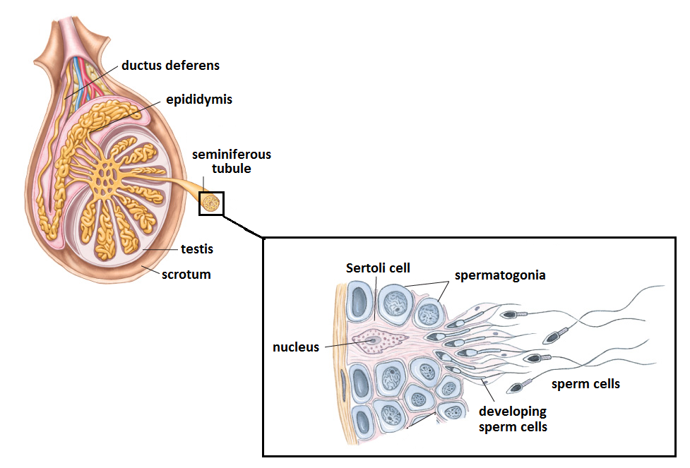
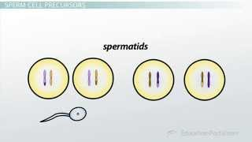
SPERMATOGENESIS
Sperm develop from precursor cells called spermatogonia within seminiferous tubules
Spermatogonia undergo two cycles of meiosis (more on this in Chapter 16) as they develop into a primary spermatocyte, then a secondary spermatocyte, and ultimately a spermatid.
Spermatids then go on to differentiate into spermatozoa (sperm)
These series of cell divisions and differentiation occur towards the middle of the seminiferous tubule, where the final spermatocyte are released into the lumen
Sertoli cells within the seminiferous tubules nourish and provide metabolic support for developing sperm. These can be easily recognized on diagrams as the largest cells in the tubule.
Sperm cells mature and gain their ability to swim in the epididymis of the testes

Slide 14
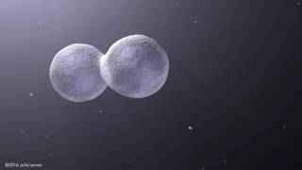
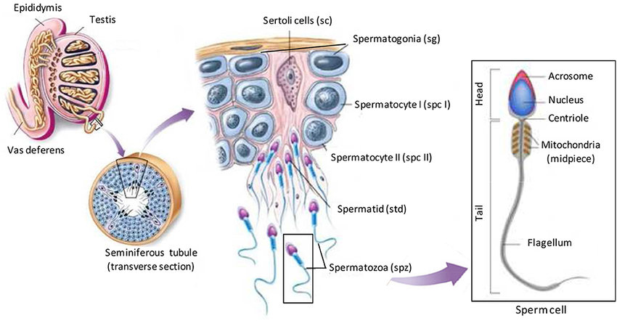
SPERMATOGENESIS
(where sperm mature and gain swimming ability)
(nourish and support the developing sperm)
Direction of development
Lumen (where sperm are released)
Lumen (where sperm are released)

Slide 15
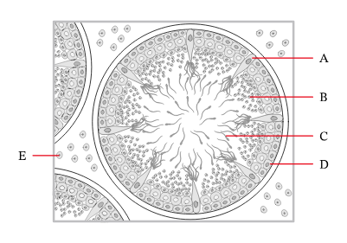
Can you label the following structures?
Sertoli cell
Spermatid
Spermatozoa (Sperm)
Spermatogonium
Interstitial cell

Slide 16
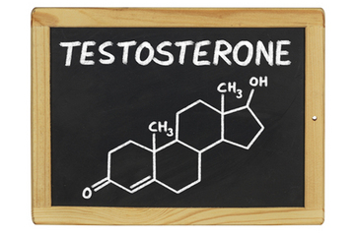
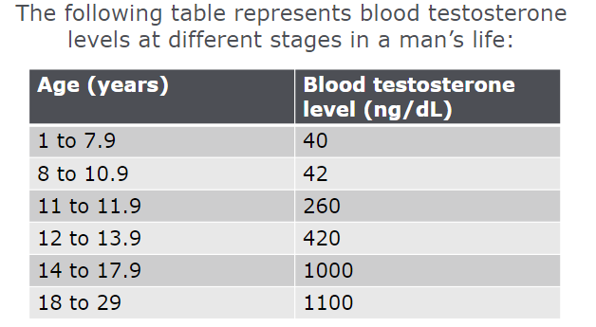
Male Sex Hormones
Male sex hormones are known as androgens. While testosterone is the primary male sex hormone, a series of other hormones are required for spermatogenesis.
Testosterone is the hormone that initiates the development of male sex organs and ducts
When a male reaches puberty, testosterone levels increase, leading to the development of secondary sex characteristics
Testosterone also plays a central role in spermatogenesis

Slide 17
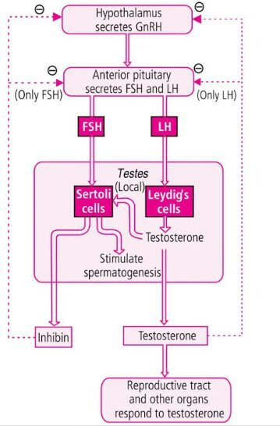
Puberty and
Hormonal Regulation of Spermatogenesis
At puberty, the hypothalamus produces Gonadotropin Releasing Hormone (GnRH), which stimulates the anterior pituitary to release two hormones:Follicle Stimulating Hormone (FSH) and Luteinizing Hormone (LH)
FSH stimulates Sertoli cells within the seminiferous tubules of the testes to start producing sperm
LH stimulates the interstitial cells within the testes to start producing testosterone
Interstitial cells
* don’t need to remember this hormone name

Slide 18
Puberty and
Hormonal Regulation of Spermatogenesis
Testosterone contributes to sperm production and also causes secondary sex characteristics to begin to develop: deepening of voice, facial hair, etc.
Hormone levels are regulated through negative feedback
* don’t need to remember this hormone name

Slide 19

Although testosterone is especially important during puberty, it is required throughout a man’s lifespan to maintain reproductive functioning and secondary sex characteristics…
Steroids, such as hGH, can disrupt reproductive hormone feedback systems
Side effects in men include shrinking testicles, low sperm count, loss of body hair, and the development of breasts

Slide 20
Over time, many men experience a gradual decline in testosterone levels. This condition is known as andropause.
SYMPTOMS INCLUDE:
Fatigue
Depression
Loss of muscle and bone mass
Decreased sperm production

Slide 21
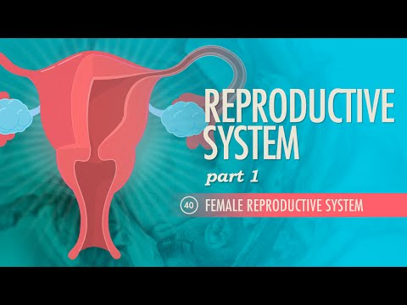
The Female Reproductive System

Slide 22
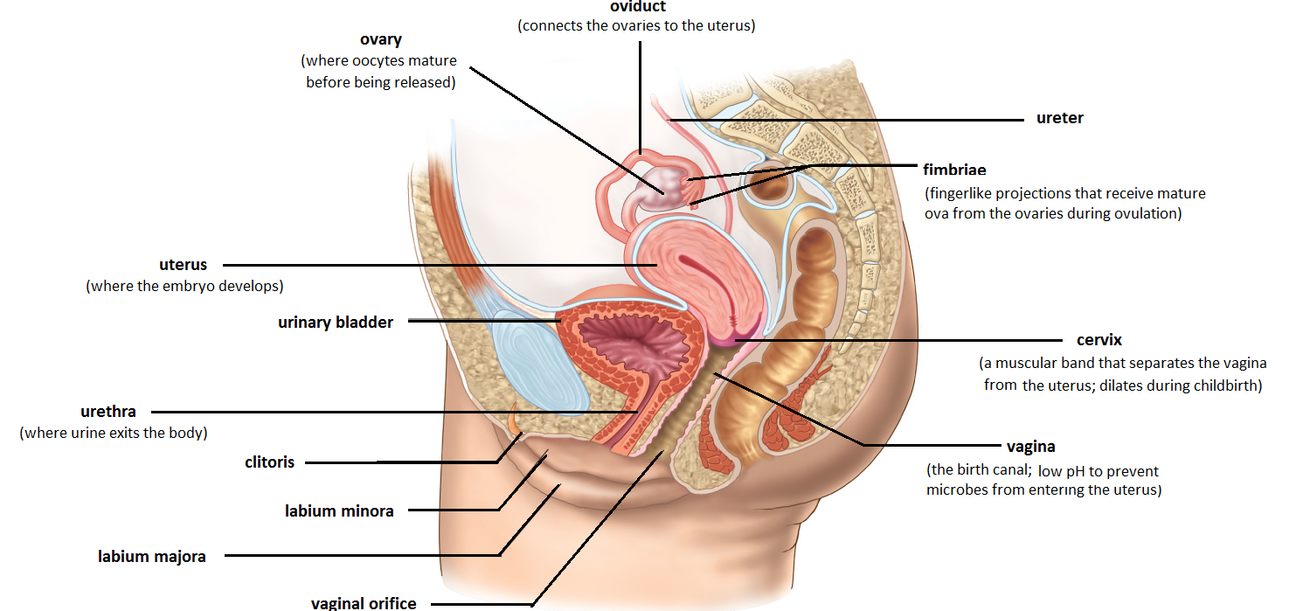
The Female Reproductive System
Connects ovaries to the uterus - normal site of fertilization
*
*
*
*
*
*will not be tested

Slide 23
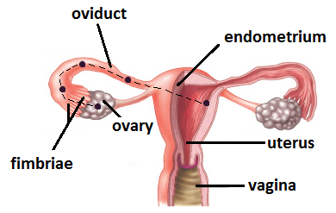
The Ovaries
Each month, a single mature egg (or “ovum”) is released from the ovary, allowing for potential fertilization. This process is known as ovulation.
During this period, the endometrial lining of the uterus thickens in preparation for pregnancy.
The ovum can survive in the oviduct for a period of 24 hours; if fertilization does not occur, the endometrial lining will then be shed. This process is known as menstruation.

Slide 24
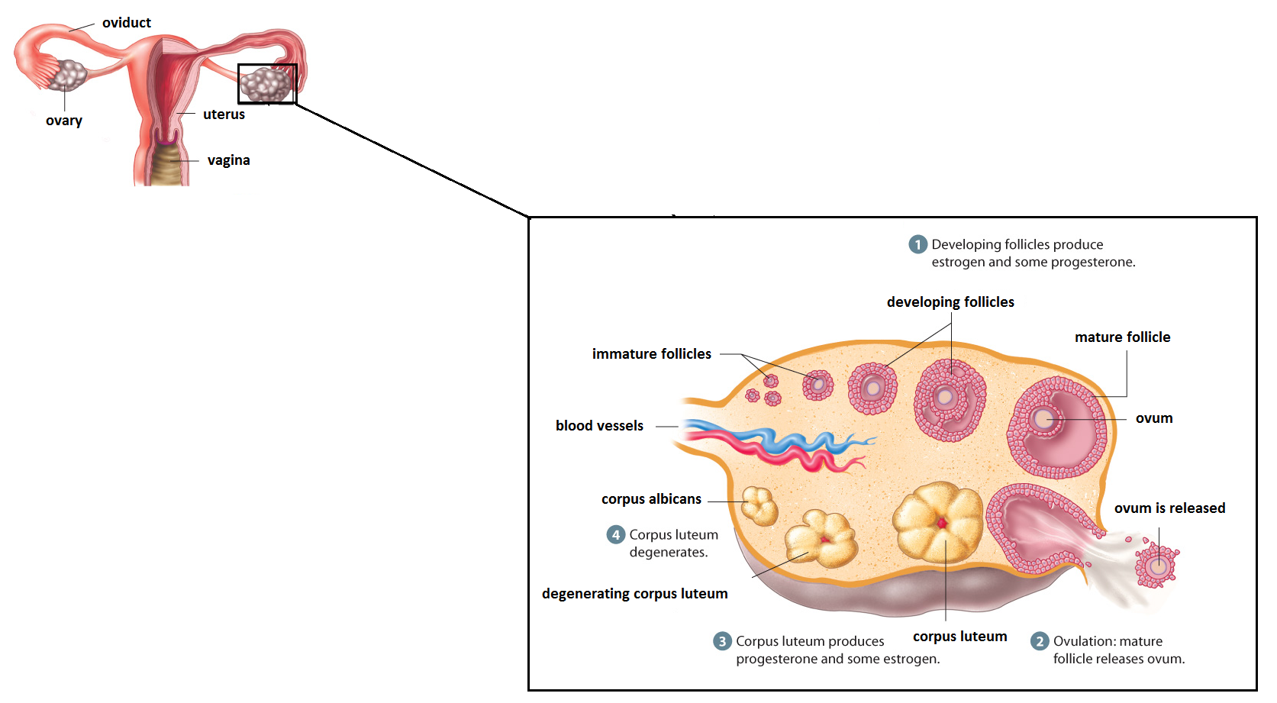
OOGENESIS
Occurs within the follicle cells of the ovaries; follicle cells provide nutrients necessary for the ovum’s development
  The maturing follicle releases increasing amounts of estrogen which helps build the endometrial lining
Once the ovum is released, surrounding follicle cells form the corpus luteum
  The corpus luteum releases some estrogen, but mostly progesterone which helps maintain the endometrial lining in case fertilization occurs and implantation expected
  If no fertilization occurs, the corpus luteum will degenerate in about 14 days

Slide 25
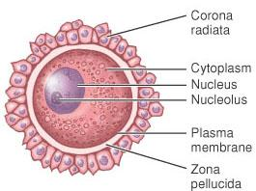
A mature ovum:
Females are born with a finite amount of oocytes; after a certain age, then, women no can longer ovulate (menopause)
Surrounded by two key layers (do not need to know)
the corona radiata, which supplies vital proteins to the cell
a specialized coating called the zona pellucida, which can only be penetrated by a single sperm
Non-motile

Slide 26
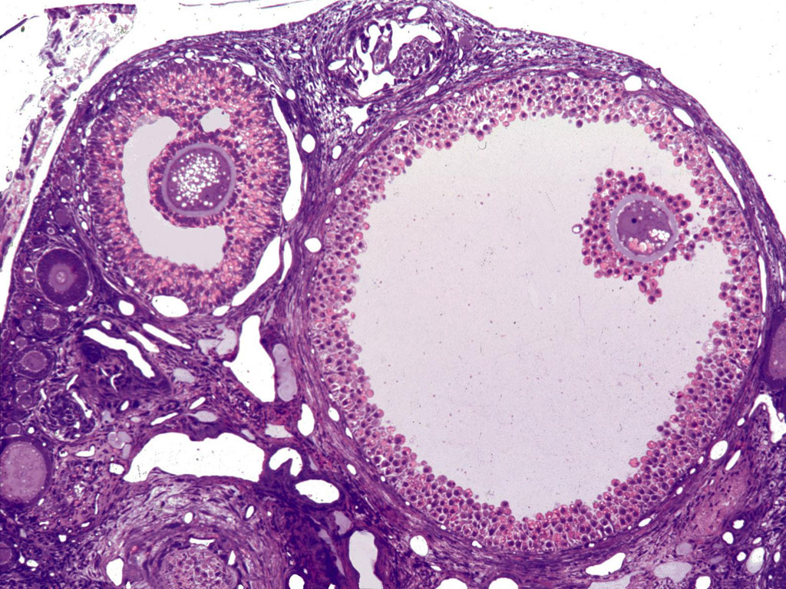
An immature oocyte developing within a follicle:
follicles
zona pellucida
oocyte
corona radiata

Slide 27
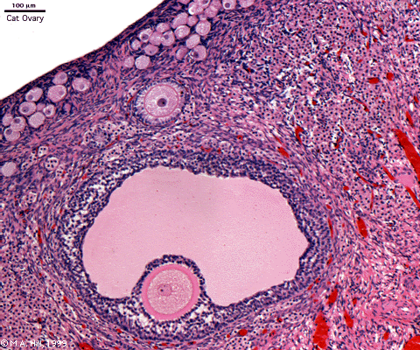
Female Sex Hormones
Like in males, puberty begins when the hypothalamus triggers the release of LH and FSH from the pituitary. However, in females…
FSH stimulates the development of female sex organs as well as follicle development within the ovaries. As the follicle develops, it releases estrogen.
LH triggers ovulation (signals egg maturation)
This marks the beginning of a young woman’s reproductive years; associated hormones also stimulate the development of secondary sex characteristics.

Slide 28
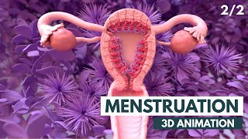

Hormonal regulation of the female menstrual cycle is complex. Watch both videos to get an increasing in-depth understanding of it. There are summary notes on the next pages and a diagram, but that will not give you the whole picture.
Watch first
Watch second

Slide 29
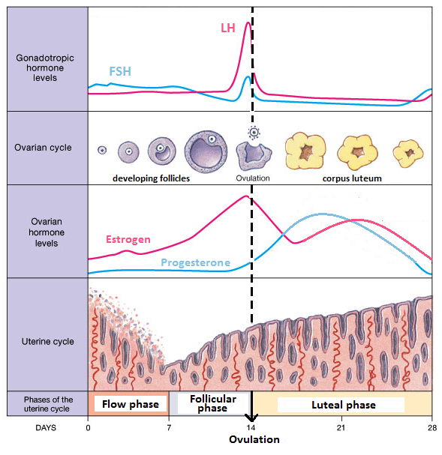
THE MENSTRUAL CYCLE
Divided into four phases…
Flow phase (days 0-7)
  A.k.a. Menstruation
  Marks the beginning of the cycle
  Characterized by shedding of the endometrium
  Estrogen/progesterone levels are at their lowest

Slide 30
THE MENSTRUAL CYCLE
Divided into four phases…
Follicular phase (days 7-14)
  GnRH stimulates the release of FSH from the pituitary, which causes a follicle cell within the ovary to mature.
  As the follicle develops, estrogen is secreted, promoting the development of the endometrium
  Rising levels of estrogen then inhibit the release of FSH from the pituitary

Slide 31
Ovulatory phase (day 14)
  Estrogen also triggers a sharp increase in LH production, which signals the release of the mature ovum from the follicle
  Once this occurs the follicle begins to form the corpus luteum
  Since there no no more follicle to release estrogen, we see a temporary decrease in estrogen levels

Slide 32
Luteal phase (days 14-28)
  Once the corpus luteum forms it begins to secrete estrogen and progesterone. Estrogen continues to promote the development of the endometrial lining.
  Progesterone plays an important role in preparing the uterus for an embryo. Progesterone helps maintain the endometrial lining. It also inhibits LH, preventing further ovulation and firming the cervix.
  If fertilization does not occur, the corpus luteum degenerates, and hormone secretion stops, causing the endometrial lining to be shed (beginning of flow phase)
Note: some sources only consider two separate phases, where 0-14 is follicular phase and 14-28 is luteal phase)

Slide 33
Pause here and try to describe all of the changes that occur during the menstrual cycle, and all causes and effects.

Slide 34
Eventually, women stop producing eggs. Hormone levels decline, leading to a condition known as menopause.
SYMPTOMS:
“hot flashes”
High cholesterol
Diminished bone mass
Changes in mood

Slide 35
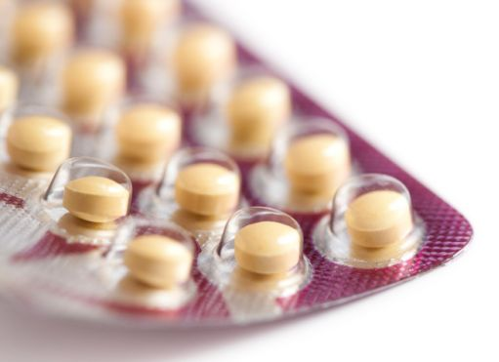
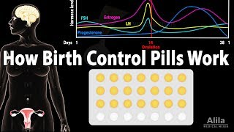
How do birth control pills prevent pregnancy?
Birth control pills typically contain high doses of progesterone and estrogen, which inhibit release of FSH and LH through negative feedback. Without FSH and LH, a follicle is unlikely to mature and ovulation will not occur.

